Slide 1
LOGIN360
MOHANPRASATH . S

Slide 2
PROJECT : )
TOPIC : )
DEPLOYING 10 MICROSERVICES USING
CI/CD USING JENKINS AND AMAZON EKS
...ONLINE BOUTIQUE ...

Slide 3
# CONNECT INSTANCE
Step 1:
Setting Up Your EC2 Instance
First, launch an EC2 instance that will act as the central point for configuring and managing your Kubernetes cluster, Jenkins, and the deployment pipeline.
EC2 Instance: Use a t2.large instance type running Ubuntu.

Slide 4
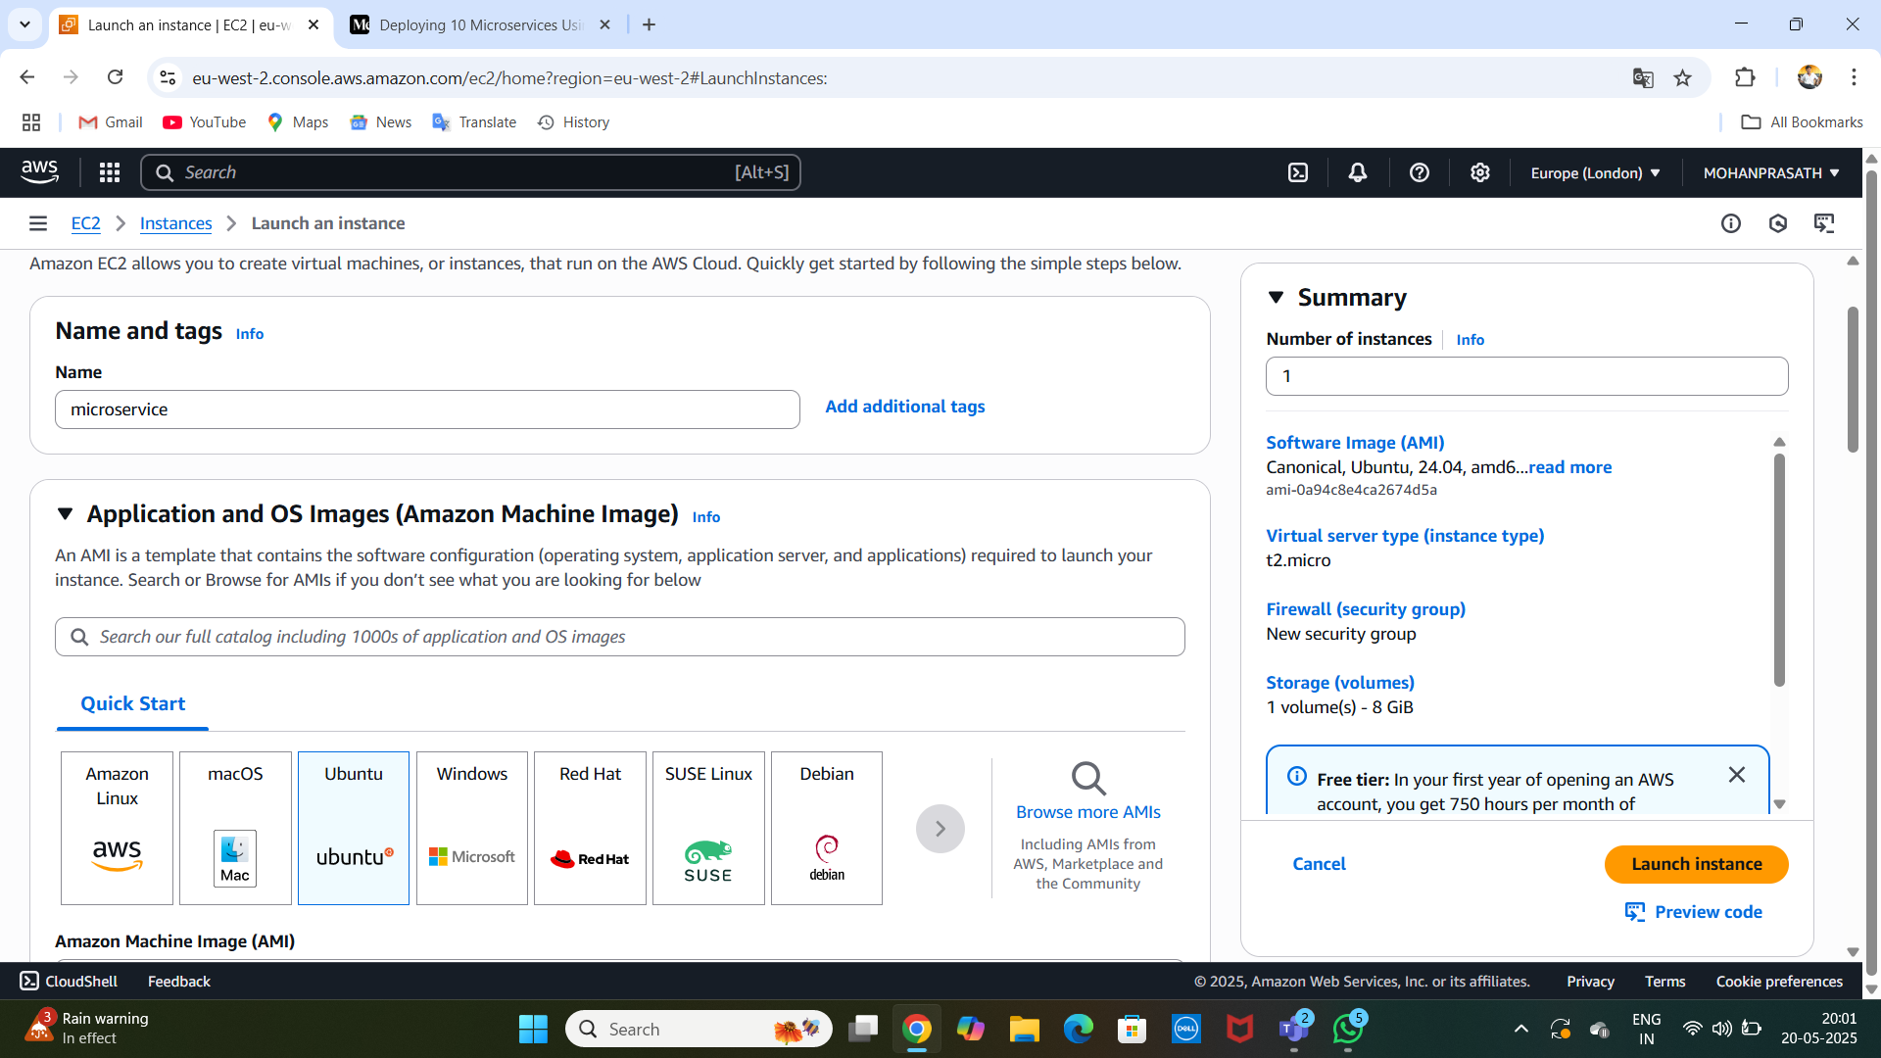
..

Slide 5
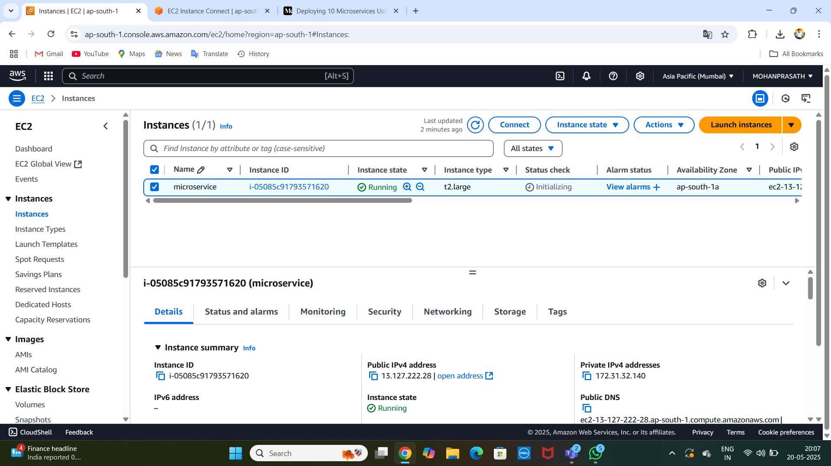
LAUNCHED : }

Slide 6
IAM POLICY CREATED : }
Next, create a new IAM user with specific policies that allow it to interact with AWS services such as EKS, EC2
IAM Policies to attach to the user:
AmazonEC2FullAccess
AmazonEKSClusterPolicy
AmazonEKSWorkerNodePolicy
AWSCloudFormationFullAccess
IAMFullAccess

Slide 7
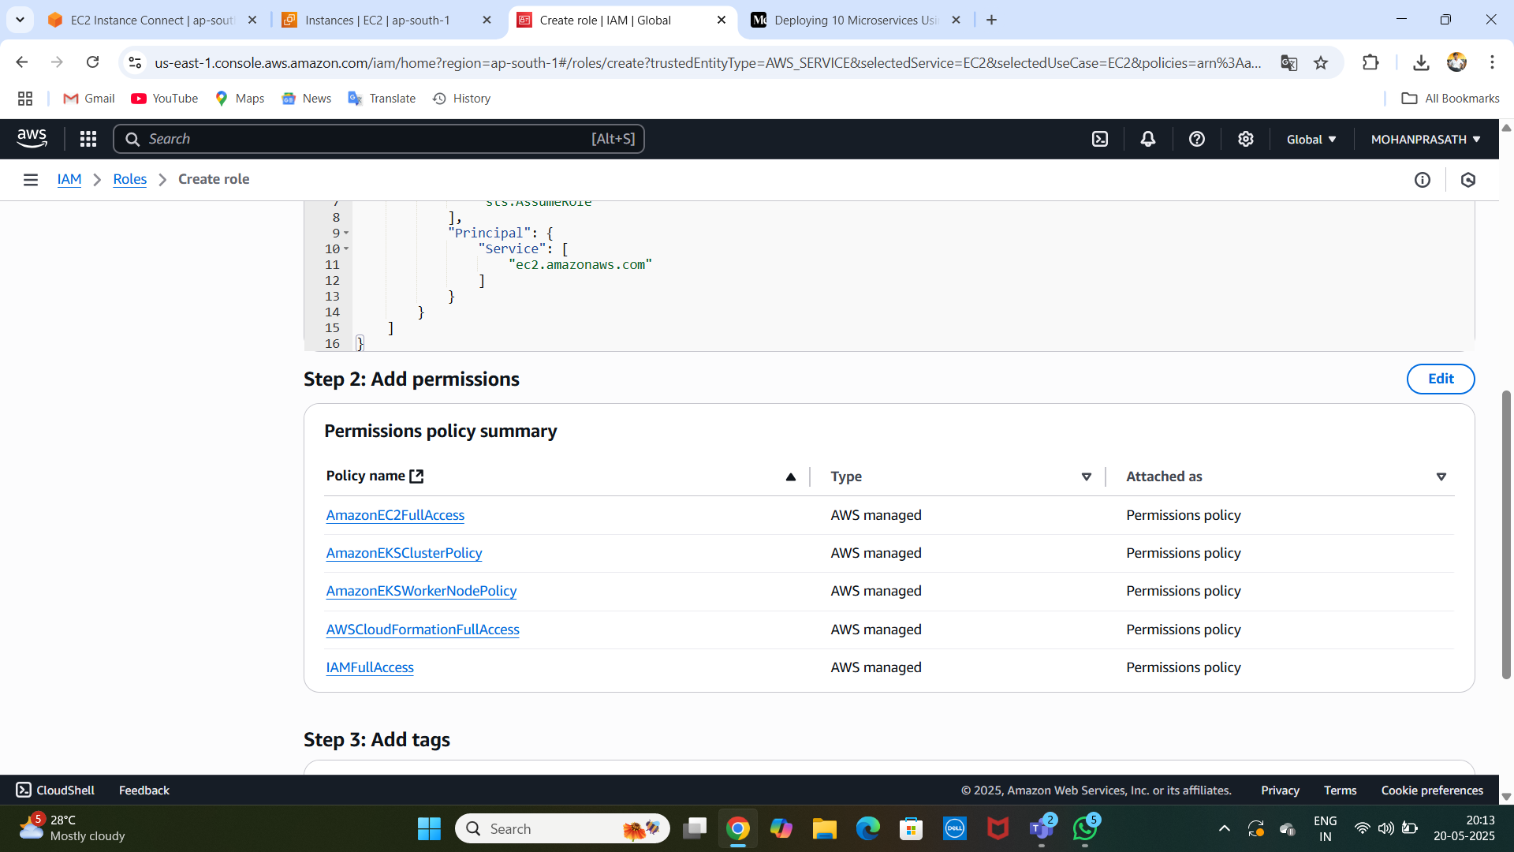
[POLICY ADDED ] :

Slide 8
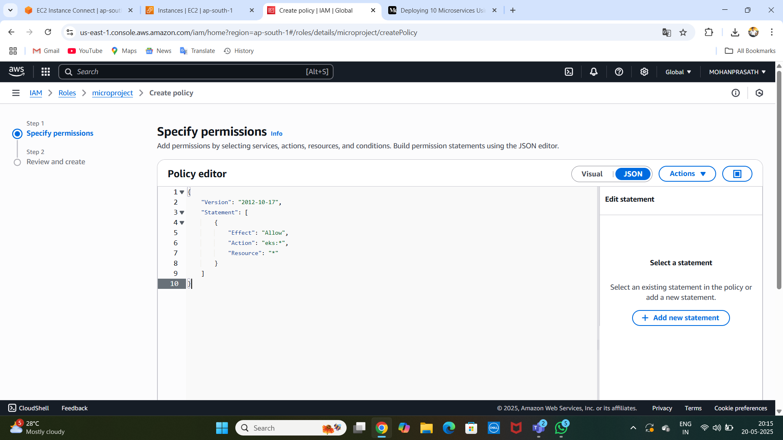
create a custom policy named eks_policy JSON configuration:

Slide 9
Step 3: Install AWS CLI, kubectl, and eksctl
AWS CLI Installation:
curl "https://awscli.amazonaws.com/awscli-exe-linux-x86_64.zip" -o "awscliv2.zip"
sudo apt install unzip
unzip awscliv2.zip
sudo ./aws/install
kubectl Installation:
curl -o kubectl https://amazon-eks.s3.us-west-2.amazonaws.com/1.19.6/2021-01-05/bin/linux/amd64/kubectl
chmod +x ./kubectl
sudo mv ./kubectl /usr/local/bin
kubectl version --short --client

Slide 10
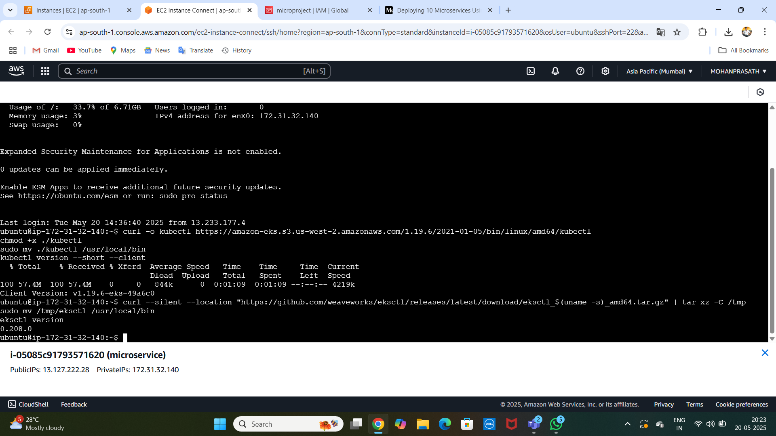
..

Slide 11
Step 4: Configure AWS CLI
You will be prompted to enter:
Access Key
Secret Key
Default region (e.g., ap-south-1)
Output format (e.g., json)

Slide 12
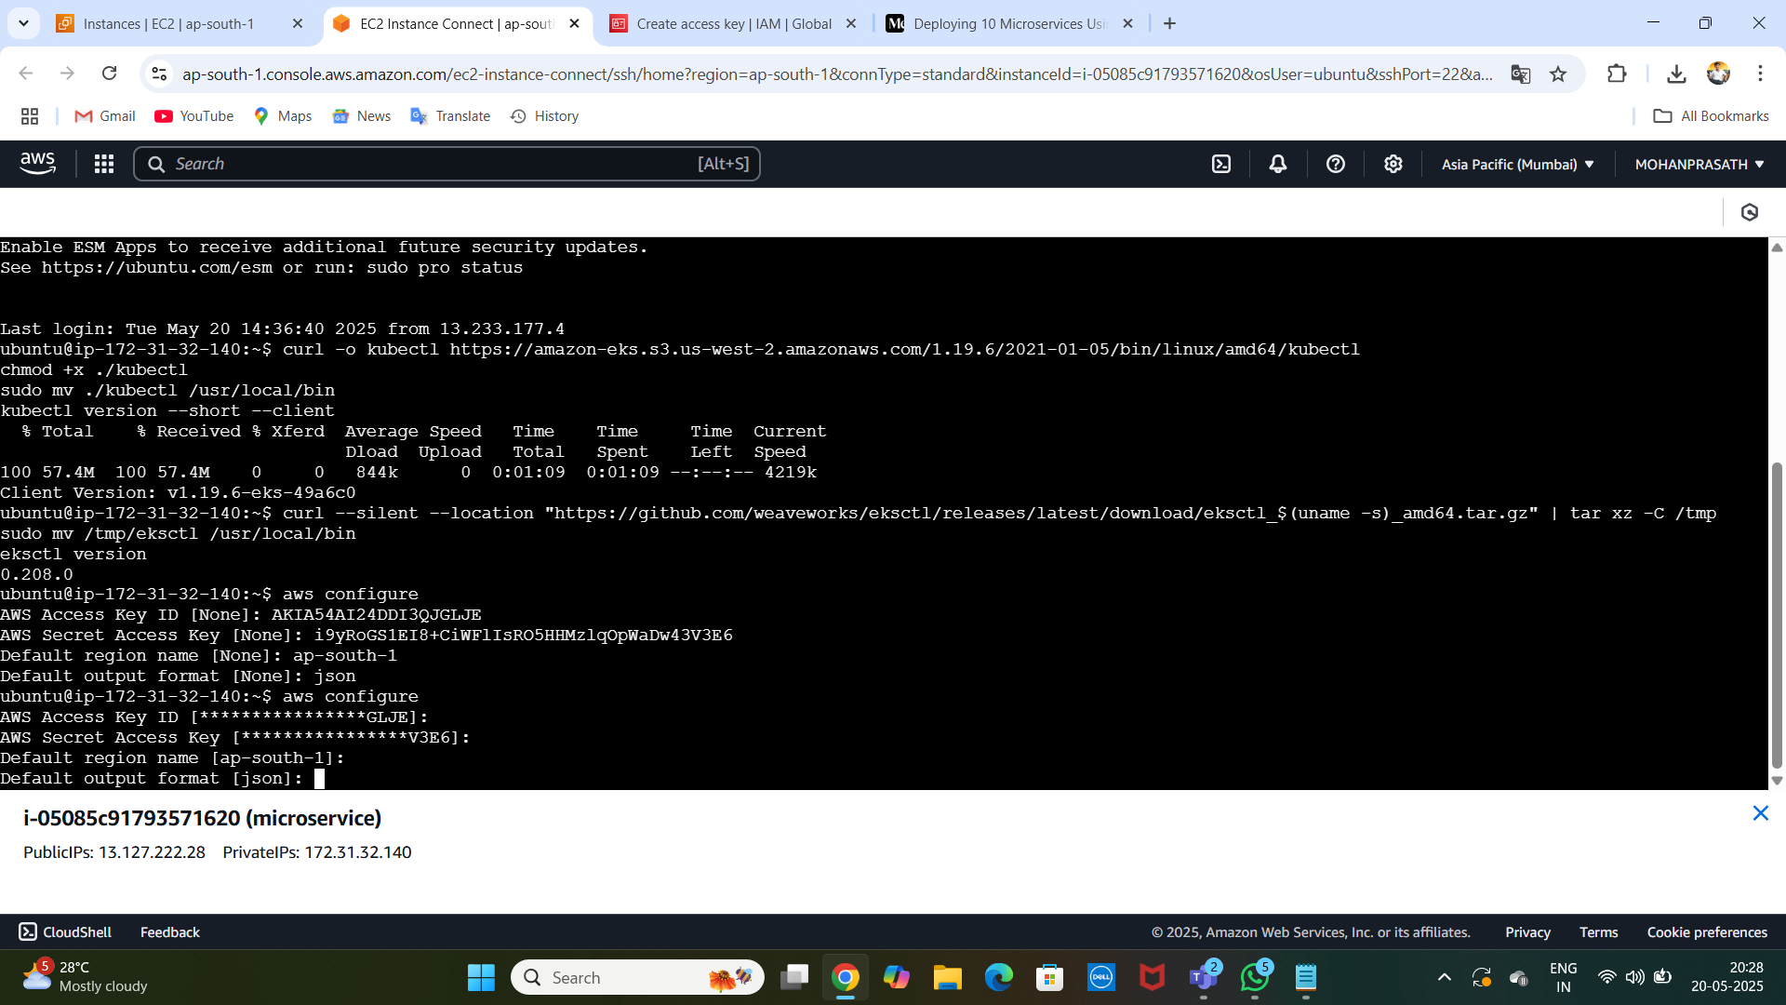
CONFIGURE :

Slide 13
Step 5: Create EKS Cluster
eksctl Installation:
// curl --silent --location "https://github.com/weaveworks/eksctl/releases/latest/download/eksctl_$(uname -s)_amd64.tar.gz" | tar xz -C /tmp
sudo mv /tmp/eksctl /usr/local/bin
eksctl version //
CONFIGURATION :
eksctl create cluster --name=EKS-1 --region=ap-south-1 --zones=ap-south-1a,ap-south-1b --without-nodegroup

Slide 14
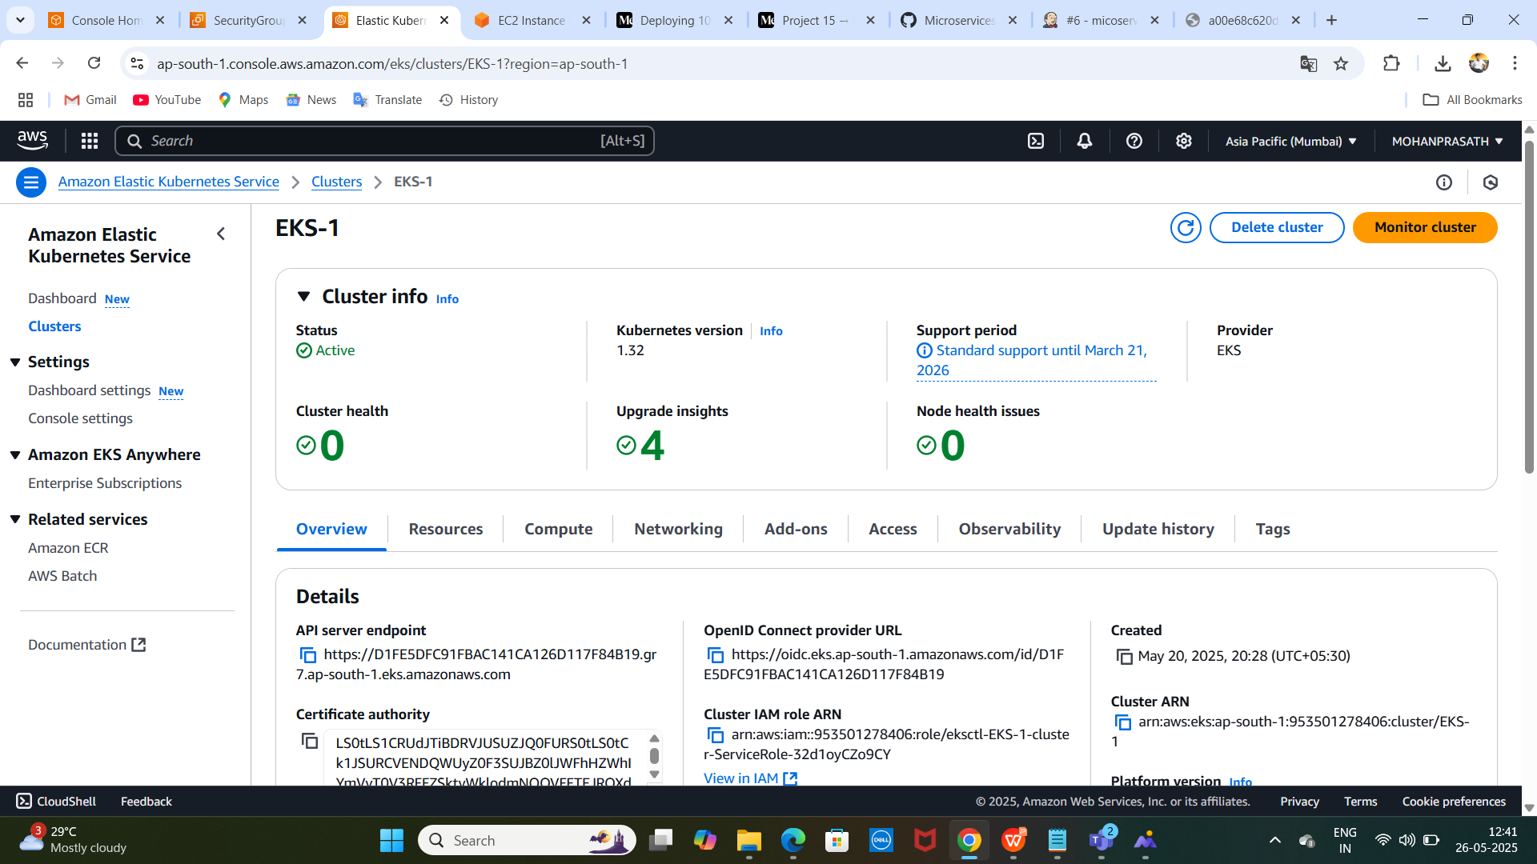
Create a eks : }

Slide 15
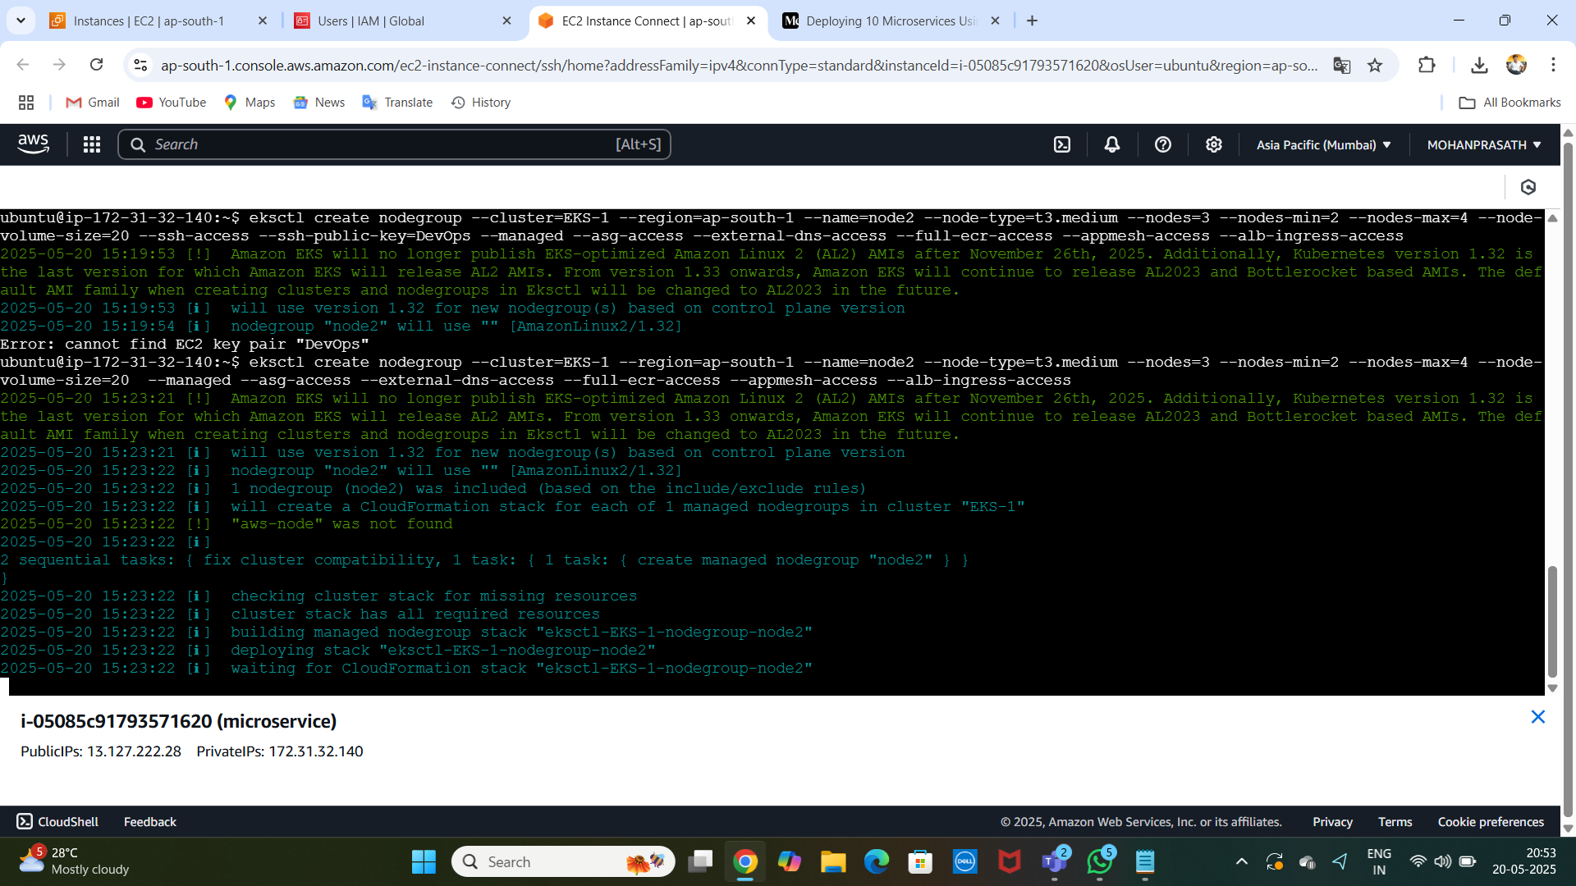
Create Node Group: )

Slide 16
Step 6: Install Jenkins on EC2 Instance
Install Java:
sudo apt install openjdk-17-jre-headless
sudo wget -O /usr/share/keyrings/jenkins-keyring.asc https://pkg.jenkins.io/debian-stable/jenkins.io-2023.key
echo "deb [signed-by=/usr/share/keyrings/jenkins-keyring.asc] https://pkg.jenkins.io/debian-stable binary/" | sudo tee /etc/apt/sources.list.d/jenkins.list > /dev/null
sudo apt-get update
sudo apt-get install jenkins

Slide 17
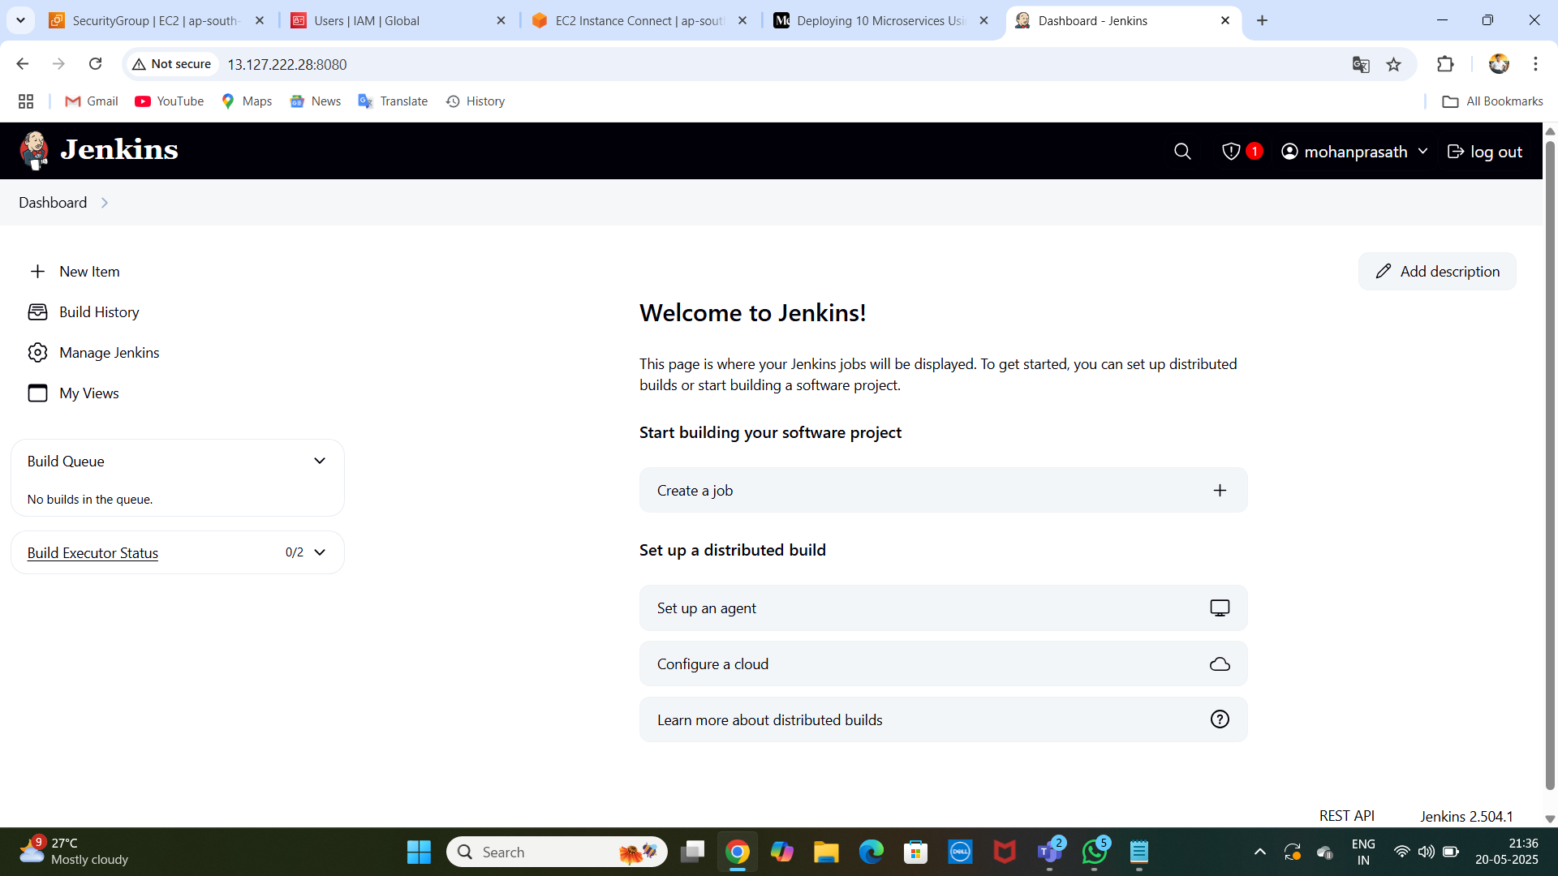
JENKINS DASHBOARD :

Slide 18
TOOLS :
Install Plugins: Install the following Jenkins plugins:
Docker
Docker Pipeline
Kubernetes
Kubernetes CLI
Scan by webhook trigger

Slide 19
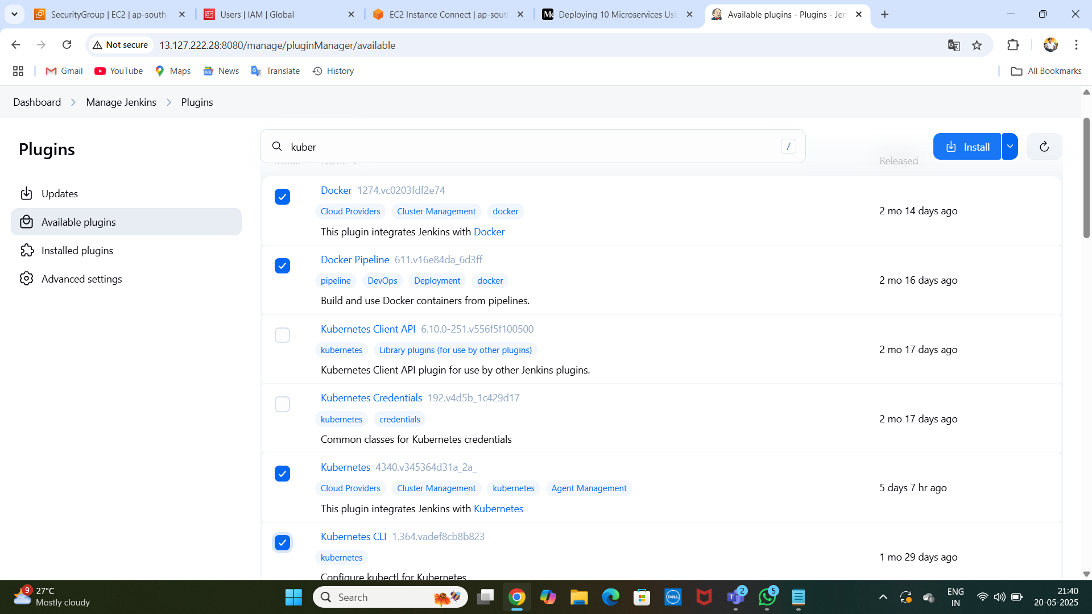
TOOLS :

Slide 20
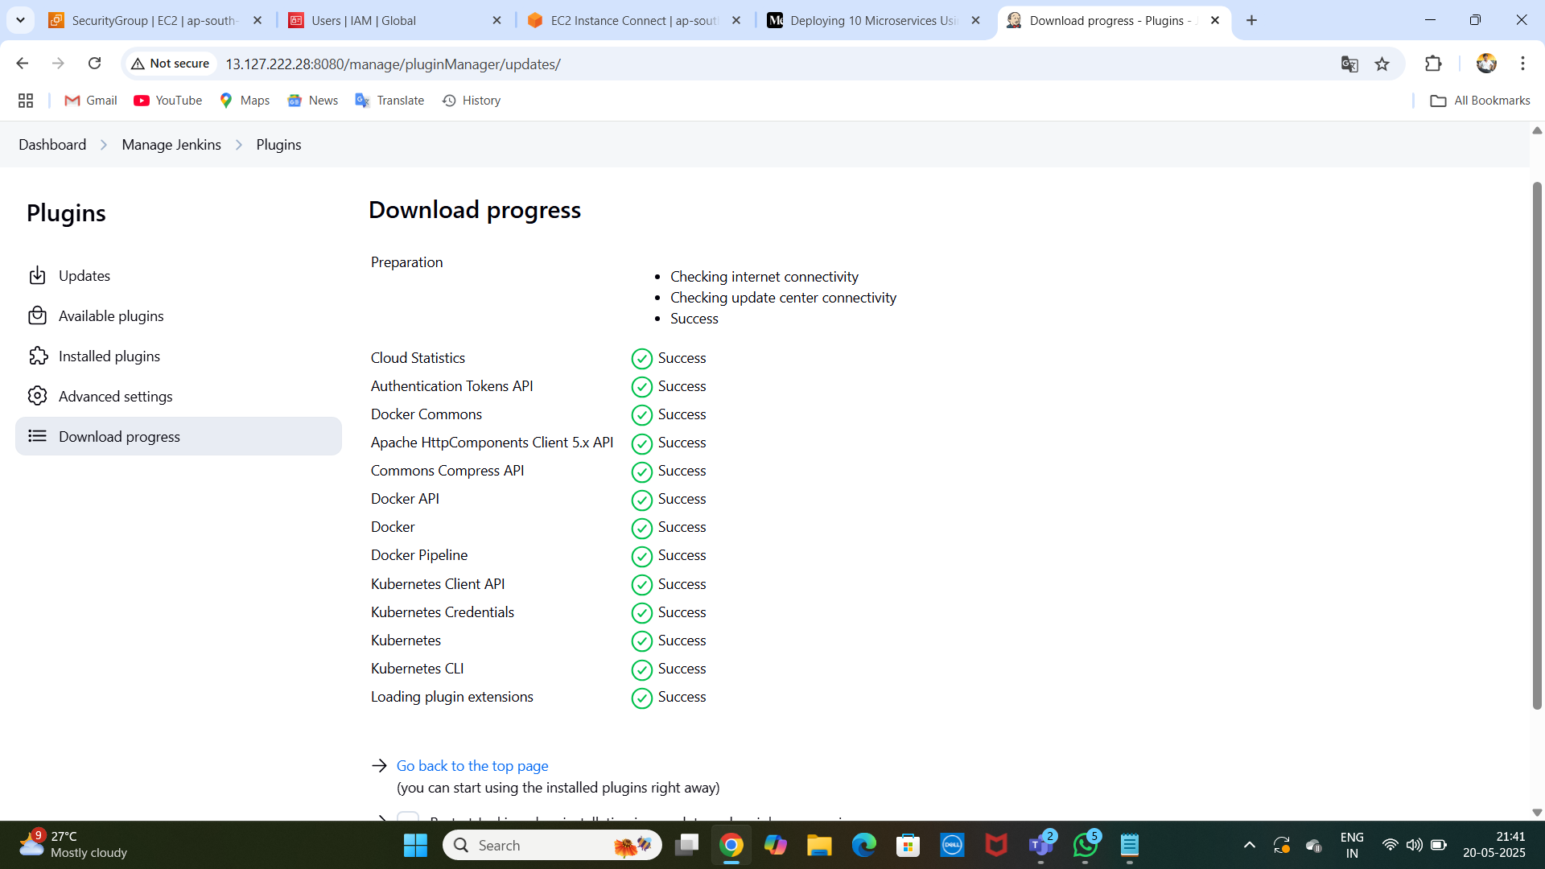
SUCCESFULL : )

Slide 21
ADD CREDENTIALS :
GIT ---- GIT-CRED
DOCKER ---- DOCKER-CRED
K8-TOKEN

Slide 22
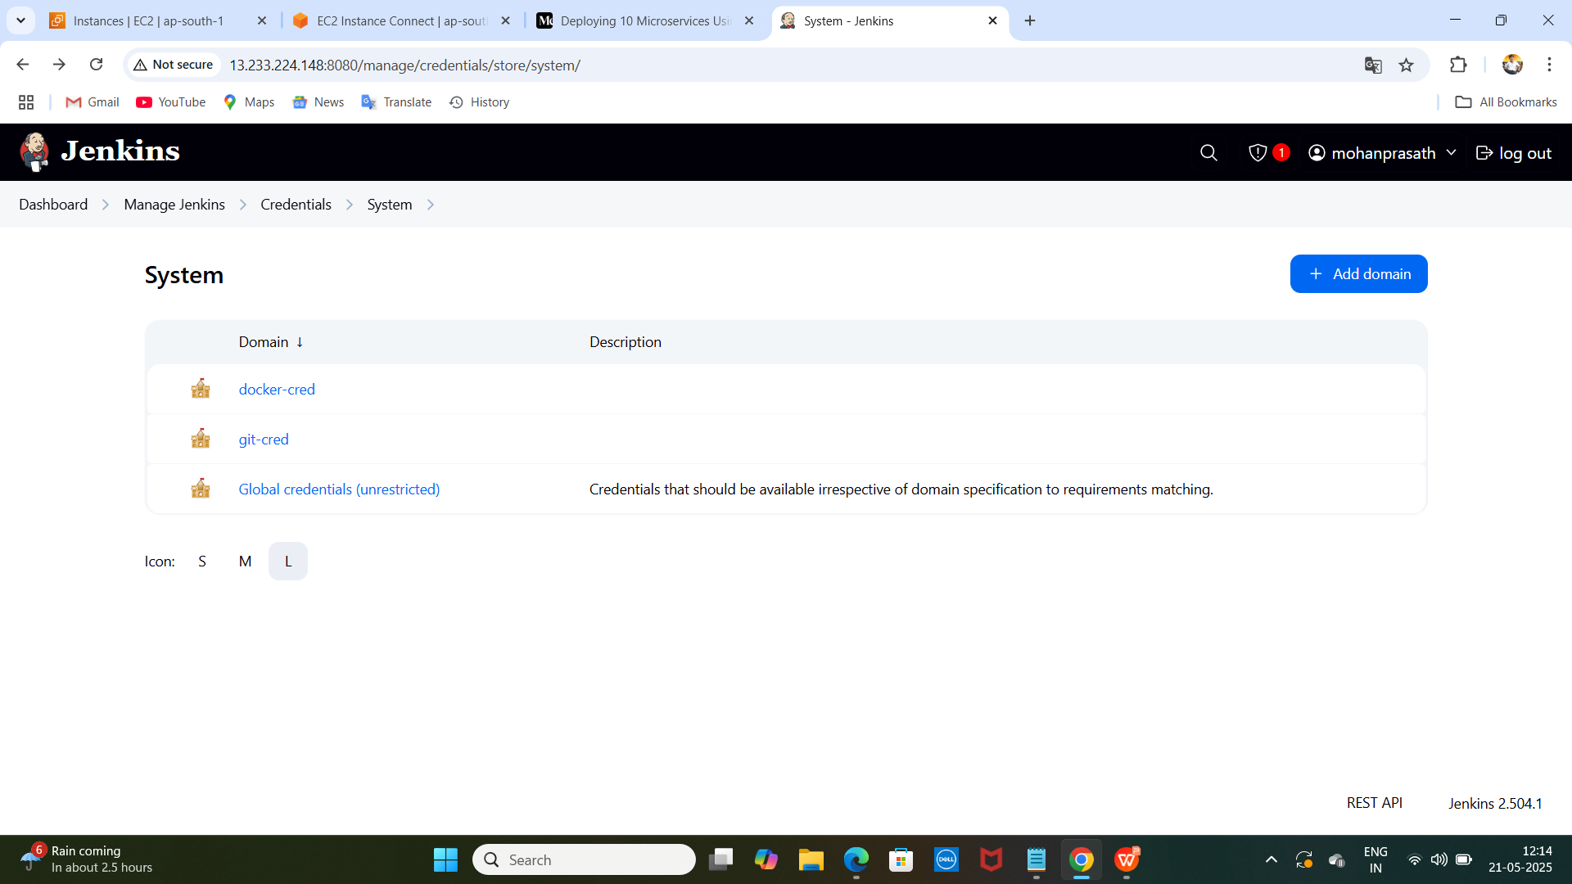
: )

Slide 23
Create Account : }
1.Creating Service Account:
2.Create Role:
3.Bind the role to service account:
4.create token file :
5.deployement.file:

Slide 24
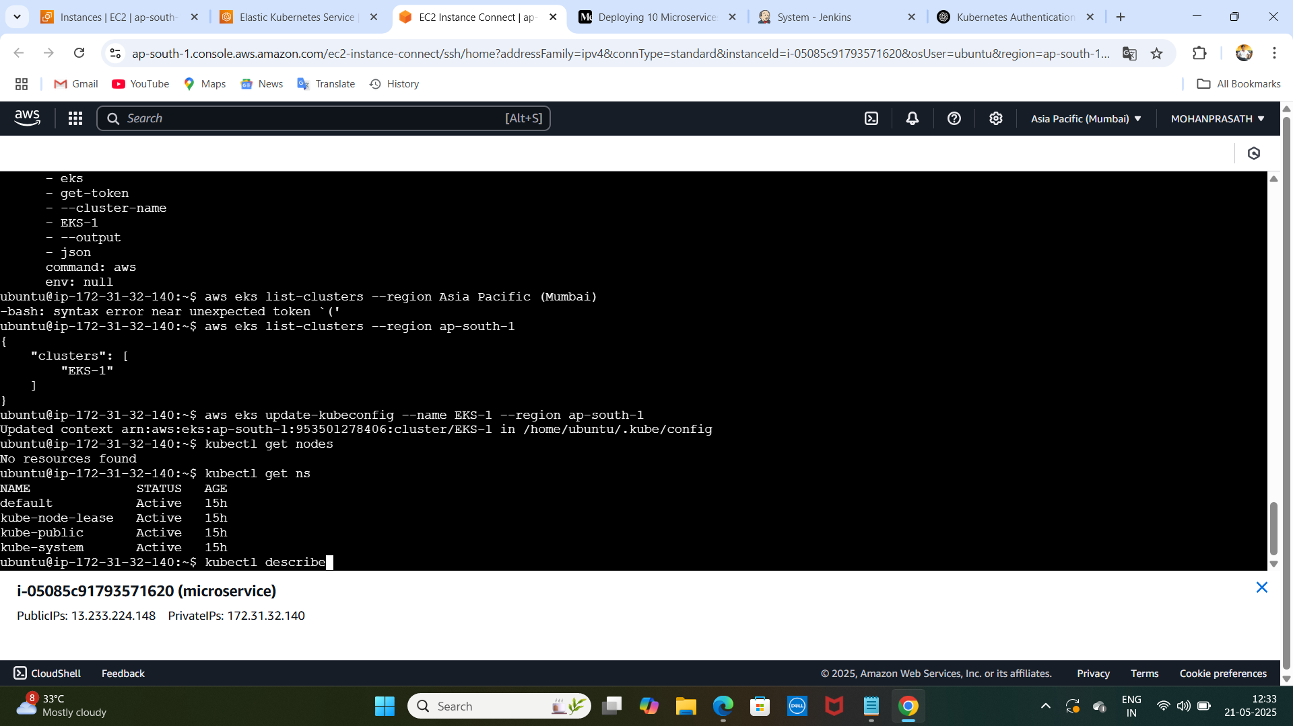
..

Slide 25
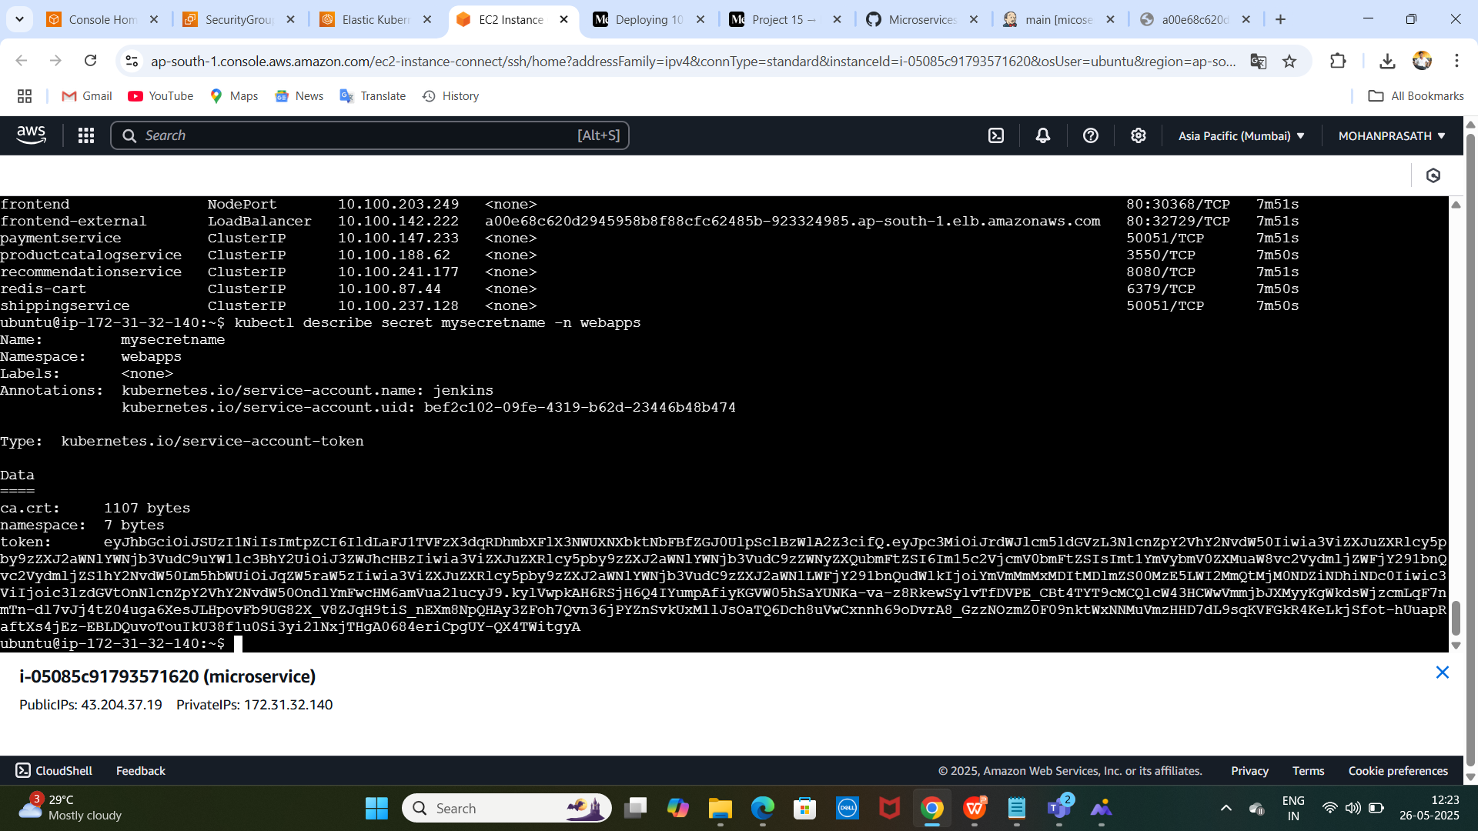
Generate token : }

Slide 26
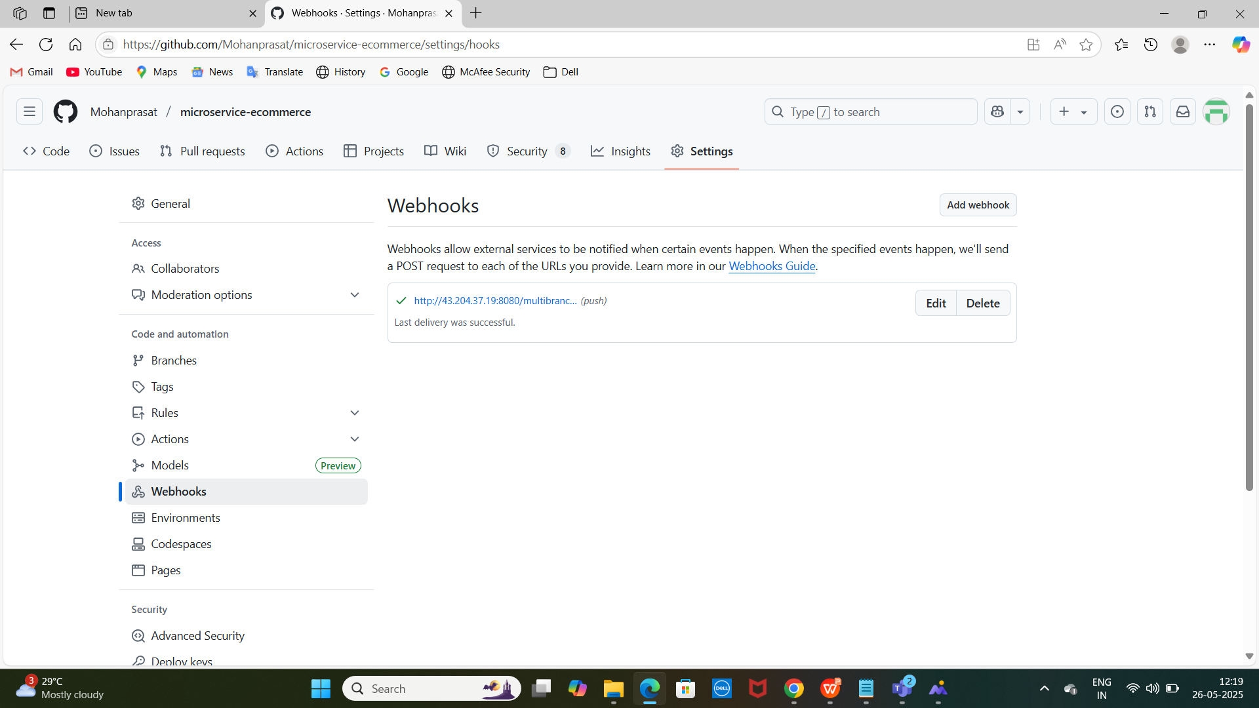
Add webhook on github : }

Slide 27
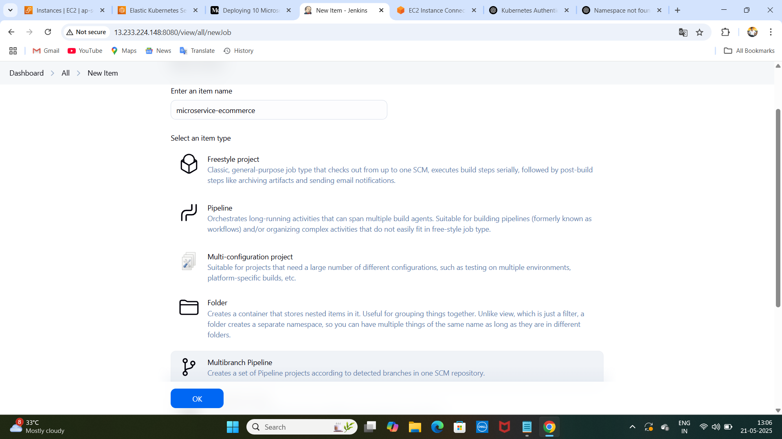
# Use jenkin dasnboard create multibranch pipeline : )

Slide 28
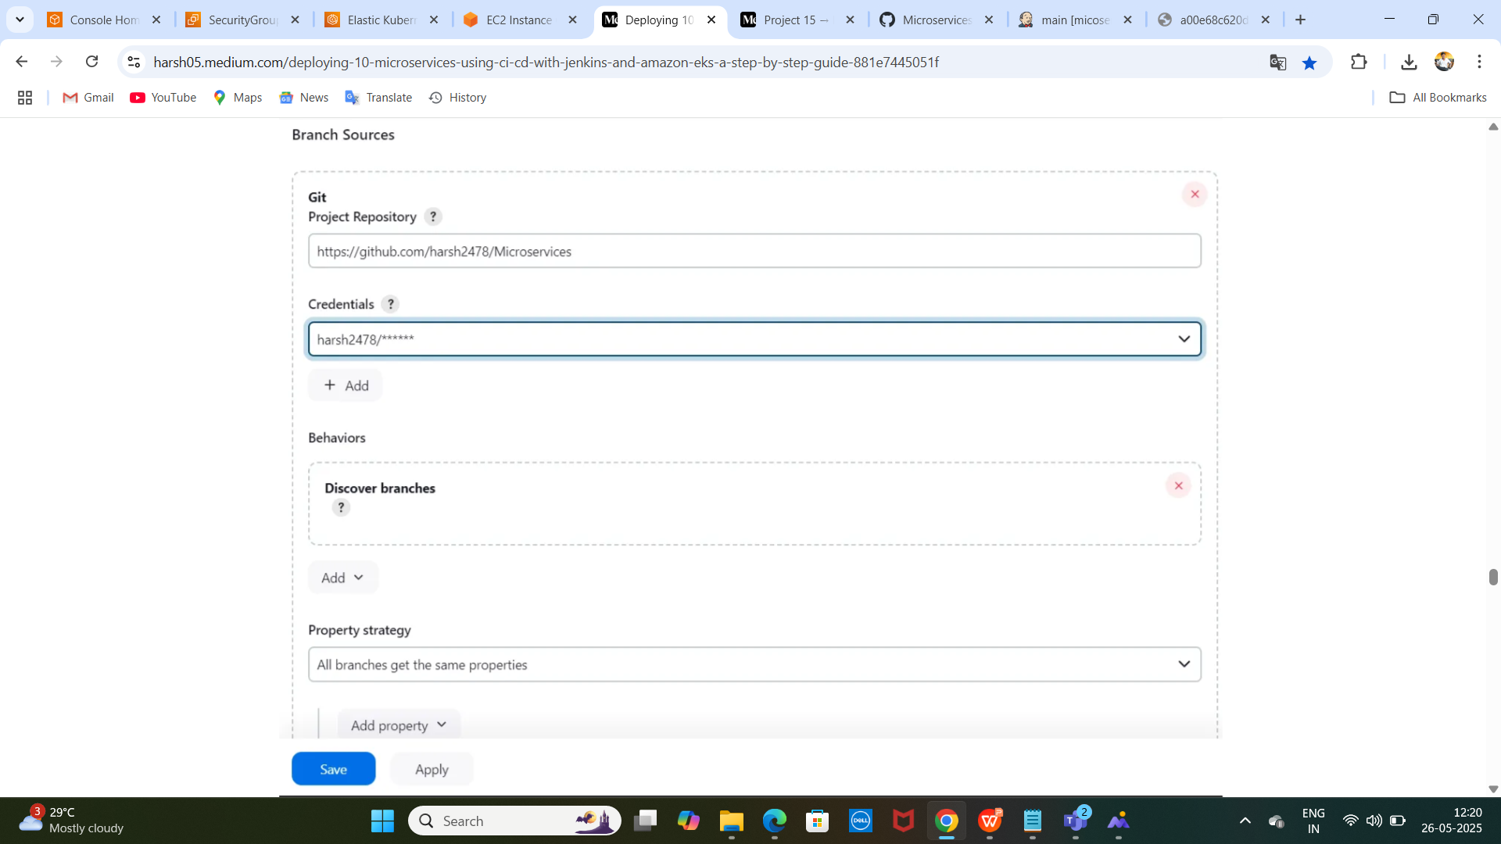
Add sources : }

Slide 29
> > >
create a jenkinsfile
craete a deploymentfile
to push the two files in github
refresh your jenkins dashboard
open the multibranch pipeline access the microservices
open your branches (main & master )
creating the 10 miceoservices on the branches

Slide 30
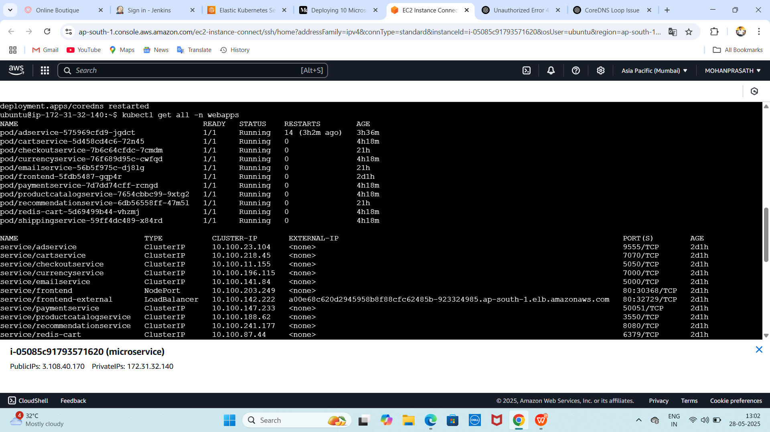
Acces the web command : } click load balancer acces the microservice : }

Slide 31
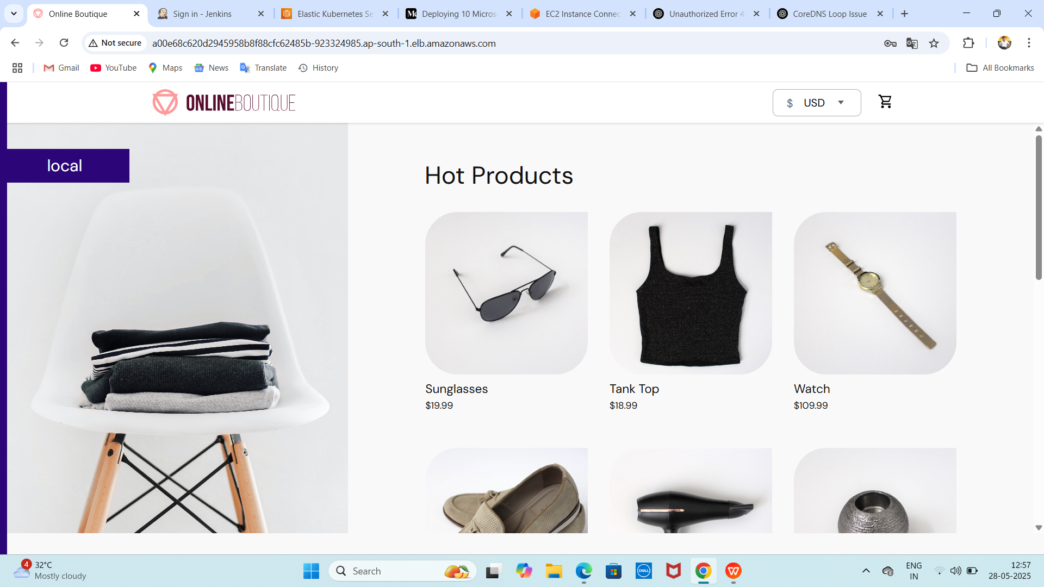
Open the browser : }

Slide 32
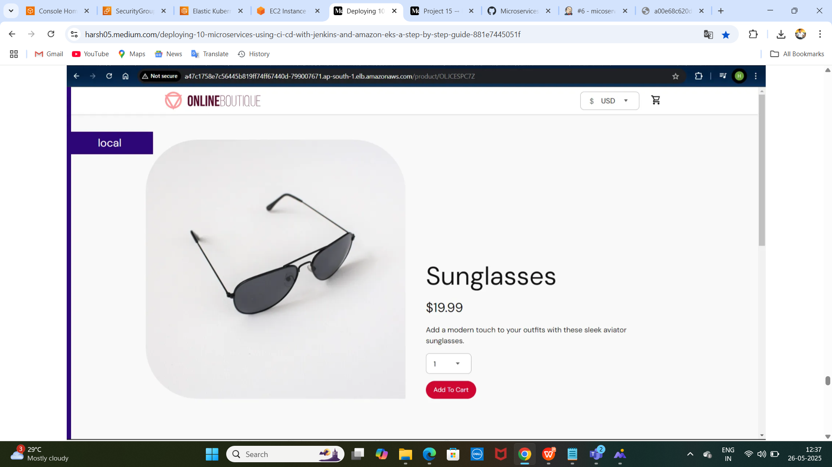
Product : )

Slide 33
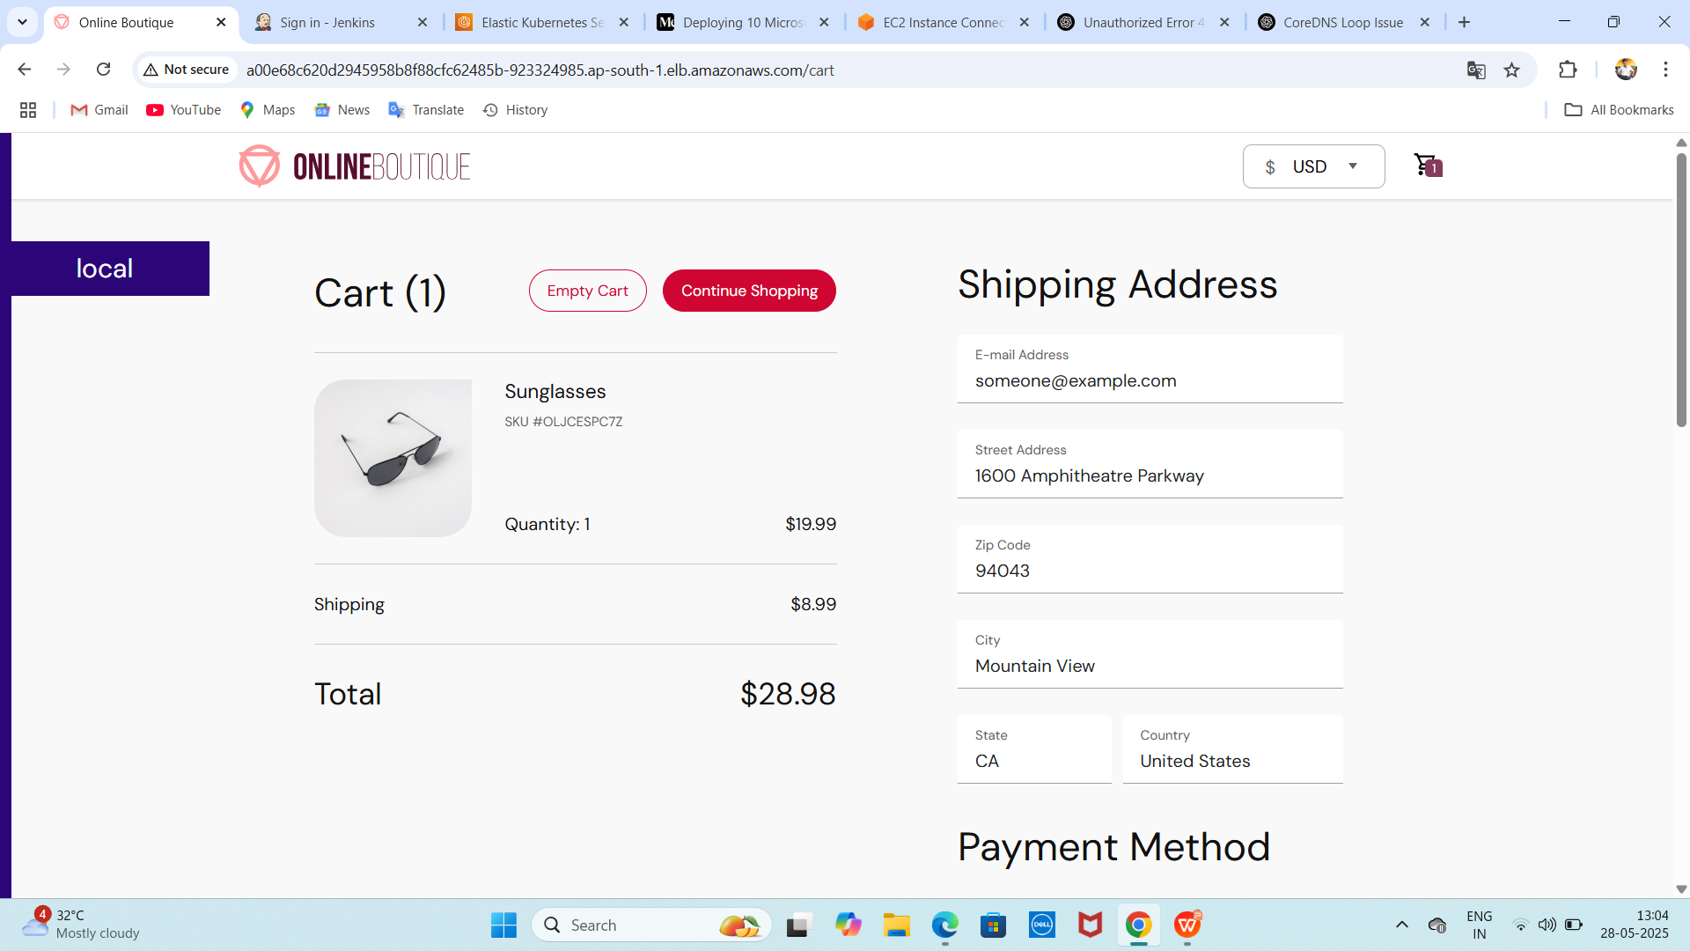
shopping :}

Slide 34
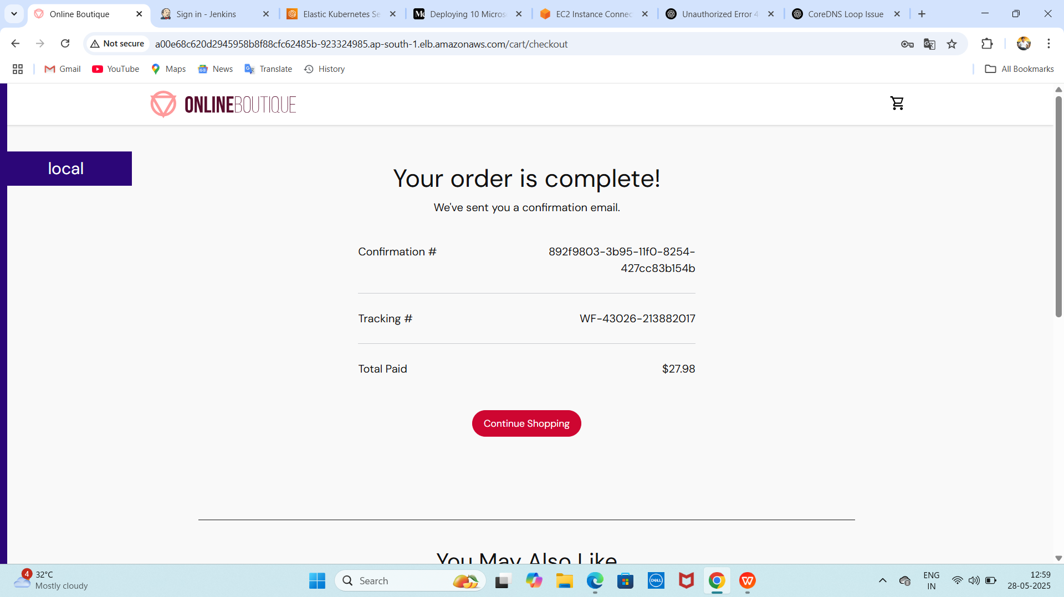
complete the order : }

Slide 35
: } ---------------------------------------- : )
... THANK YOU ...

